Slide 1
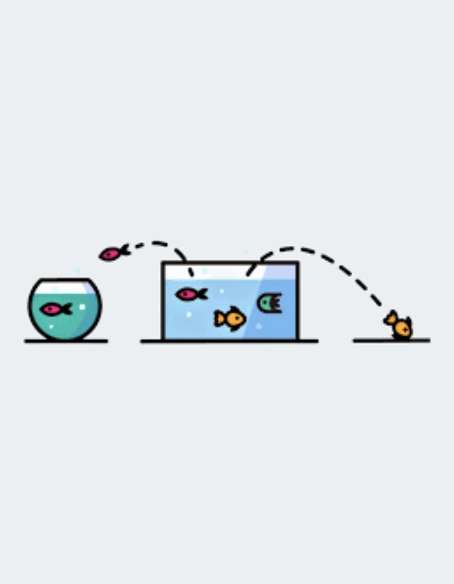

Customer Churn Prediction Model
Sanjay Malladi

Slide 2
Content
1
2
3
4
5
Introduction
Problem Statement
Data Preprocessing
Model
Development
Conclusion

Slide 3

Introduction
The customer churn prediction model is designed to identify customers who are likely to churn or stop using a product or service.
• Its goal is to enhance retention strategies by allowing businesses to proactively take action to prevent churn and retain valuable customers.’’

Slide 4
Problem Statement Importance of Predicting Customer Churn Customer churn refers to the rate at which customers stop doing business with a company. It is a critical metric for businesses across industries as it directly impacts revenue and customer satisfaction. Impact on Revenue When customers churn, businesses lose out on their recurring revenue and potential future sales. Acquiring new customers is often more costly than retaining existing ones, making customer churn a significant financial concern. Impact on Customer Satisfaction Customer churn can be indicative of underlying issues with a company's products, services, or customer experience. By predicting churn, businesses can proactively address these issues and improve overall customer satisfaction

Slide 5
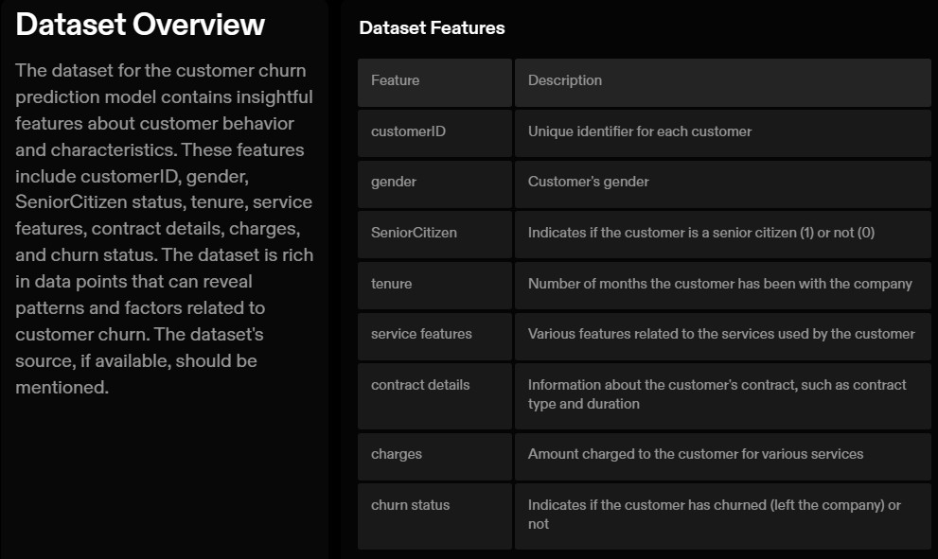

Slide 6
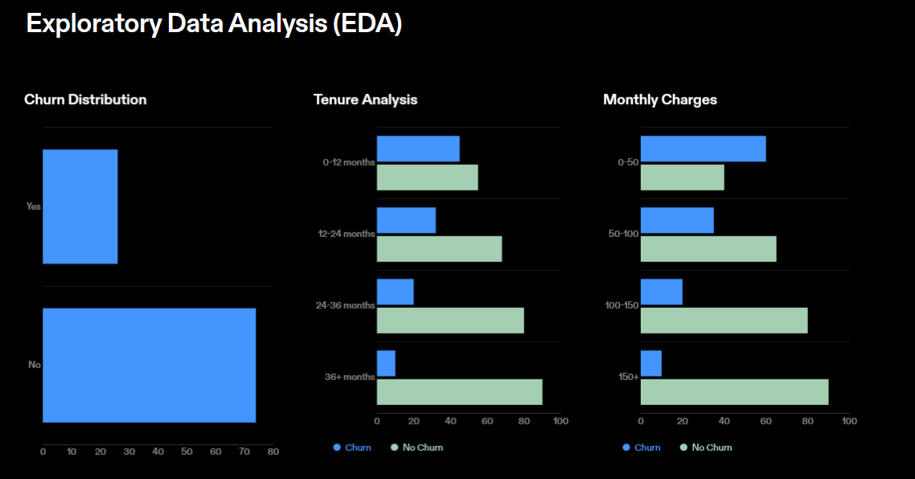

Slide 7
Data Preprocessing Data preprocessing is a crucial step in building machine learning models. It involves transforming raw data into a format that can be easily understood and processed by the model. The following are the key preprocessing steps: Handling Missing Values Missing values can negatively impact the performance of machine learning models. There are several techniques to handle missing values Encoding Categorical Variables Machine learning models typically require numerical input. Categorical variables, such as gender or product categories, need to be encoded into numerical values. Common encoding techniques include Feature Scaling Feature scaling is the process of standardizing the range of features. It is important because many machine learning algorithms perform better when features are on a similar scale.

Slide 8
Model Development Tested Models . Logistic Regression . Decision Trees . Random Forests . Boosting Algorithms Model Selection Process The model selection process involved evaluating the performance of each tested model based on various metrics such as accuracy, precision, recall, and Fl score. The rationale for choosing the best-performing model was based on its ability to accurately predict customer churn and provide insights for retention strategies.

Slide 9

Summary
The customer churn prediction model has been successfully developed and implemented.
The model has shown promising results in identifying customers at risk of churn.
The model has provided valuable insights into the factors contributing to churn and has helped in the development of effective retention strategies.
The implementation of the model has resulted in a reduction in customer churn and an increase in customer retention rates.

Slide 10


